Slide 2
Introduction to CI/CD

Slide 3

By the end of this lesson, you'll be able to:
Illustrate the traditional delivery process
Explain Continuous Integration
Define Continuous Deployment
Differentiate between Continuous Deployment and Continuous Delivery
Describe the automated deployment pipeline
Notes:
Trainer Notes: Introduce the topics to be covered

Slide 4
Traditional Software Development
Notes:
Trainer Notes: Introduce subtitle

Slide 5

Traditional Delivery Process
Any delivery process begins with the requirements defined by a customer and ends with the release to production. The diagram below shows the traditional delivery process:
Development
Quality
Assurance
Operations
Product
Owner
Analysis
Planning
Integration
Testing
Release
Implementation
Acceptance
Testing
Non-Functional
analysis
Monitoring
Unit testing
Demo
Release cycle
Notes:
Trainer Notes: Explain traditional delivery process

Slide 6
Traditional Delivery Process
The release cycle starts with the requirements provided by the Product Owner. This is followed by three phases, during which the work is passed between different teams.
Quality Assurance
The QA team performs a suite of testing.
2
Development
The developers work on the product.
Operations
The Operations team does the release and monitors the production.
1
3
Notes:
Trainer Notes:
Development:
The developers work on the product, often using some Agile technique like Scrum or Kanban. After the implementation, the code is passed to the QA team.
Quality Assurance:
The QA team performs a suite of Integration Testing, Acceptance Testing, and Non-functional Testing.
Any bug detected goes back to the development team.
Operations:
This involves passing the code to the Operations team to perform the release and monitor the production.
If there is a problem, developers are contacted to help the Operations team.

Slide 7
Drawbacks of Traditional Delivery Process
The most significant issues with the traditional delivery process include the following:
Slow delivery
Lower job satisfaction
Long feedback cycle
Drawbacks
Shared Responsibility
Lack of automation
Poor Communication
Stress
Notes:
Trainer Notes: Explain drawbacks
Risky hotfixes: Hotfixes can't usually wait for the full UAT phase, so they tend to be tested differently (the UAT phase is shortened) or not tested at all.
Slow delivery: The customer receives the product long after the requirements were specified, resulting in an unsuitable market.
Long feedback cycle: Bugs are only identified later in the testing phase.
Lack of automation: Rare releases don't encourage automation, leading to unpredictable releases.
Stress: Unpredictable releases are stressful for the operations team.
Poor communication: Work passed from one team to another causes people start to care only about their part, rather than the complete product. In case anything goes wrong, that usually leads to the blaming game instead of cooperation.
Shared responsibility: No team takes the responsibility for the product from A to Z. For developers: "done" means that requirements are implemented. For testers: "done" means that the code is tested. For operations: "done" means that the code is released.
Lower job satisfaction: Each phase is interesting for a different team, but other teams need to support the process. For example, the development phase is interesting for developers but, during two other phases, they still need to fix bugs and support the release, which usually is not interesting for them at all.

Slide 8
Continuous Integration

Slide 9
Introduction
Integration phase in traditional software development cycle was very hectic. During this phase, the code made by individual teams were combined into one product which required extra effort and caused conflicting changes.
It was difficult to anticipate the types of issues that would come up and fix them.
The process involved risks, significant delivery delays, unplanned costs, and unhappy clients.
Continuous Integration was introduced to address these issues.
Notes:
Trainer Notes: Introduce CI
Integration in software engineering means combining software parts (so-called subsystems) into one system.

Slide 10
Continuous Integration
Continuous Integration, in its simplest form, involves a tool that monitors your version control system and automatically compiles and tests your application whenever a change is detected.
Notes:
Trainer Notes: Explain CI

Slide 11
Advantages of Continuous Integration
Continuous Integration automatically monitors the health of your codebase, code quality, and code coverage metrics.
Technical debts are kept down and maintenance costs are low.
Publicly-visible code quality metrics encourage developers to improve their code quality.
Automated end-to-end acceptance tests provide a clear picture of the current state of development efforts.
Notes:
Trainer Notes: Explain the advantages

Slide 12
Advantages of Continuous Integration
Continuous Integration reduces risk by providing faster feedback.
CI tools are designed to help identify and fix integration and regression issues faster, resulting in fewer bugs and quicker delivery.
CI helps simplify and accelerate delivery by automating the deployment process.
Automating the deployment process helps get your software into the hands of the testers and end users faster.
Notes:
Trainer Notes: Explain the advantages

Slide 13

Continuous Integration
Continuous Integration can be defined as a development practice of code integration into a shared repository.
Each integration is verified by an automated build and automated tests.
The figure below shows the tasks involved in Continuous Integration.
Generate reports and analyze
Develop and compile
Perform functional tests and code labeling
Tasks involved in Continuous Integration
Perform unit tests
Perform pre-production deployment
Integrate with DB
Notes:
Trainer Notes: Explain the taks involved

Slide 14
Continuous Delivery

Slide 15
Continuous Delivery and Deployment
Continuous Integration lets you deploy the latest version of your application either automatically or as a one-click process.
Automating your deployment eliminates the need for human intervention. Automating the deployment process lets you push every build that passes the tests into production.
Continuous Delivery is the next step of Continuous Integration. Your code is integrated and tested, and then it is ready to be deployed with one-click.
The practice of automatically deploying every successful build directly into production is known as Continuous Deployment.
Notes:
Trainer Notes: Explain continuous delivery

Slide 16

Continuous Delivery
With Continuous Delivery, any successful build that has passed all the relevant automated tests and quality gates can potentially be deployed into production, and be in the hands of the end user within minutes.
But this process is not automatic.
It is the business, rather than IT that decides the best time to deliver the latest changes.
Notes:
Trainer Notes: Explain CD

Slide 17
Continuous Deployment

Slide 18
Continuous Deployment
Continuous Deployment is an extension of continuous integration. It targets to reduce the time between development team writing one new line of code and using it in production.
Faster return on investment for each feature as it gets developed
Faster feedback from end users on each new feature as it is released to production
Benefits
Notes:
Trainer Notes: Explain continuous deployment

Slide 19
Advantages of Continuous Deployment
Continuous deployment lets us get rid of the tedious release cycle and has the following benefits:
Fast delivery
Customers can use the product as soon as the development is complete.
Fast feedback cycle
Identifying bugs as soon as they are developed, combined with quick rollback strategy, keeps the production stable.
Low-risk releases
If you release on a daily basis, the process becomes repeatable and much safer.
Flexible release options
You can release the software without any additional time or cost spent in case of an immediate release.
Notes:
Trainer Notes: Explain advantages of continuous deployment
A software release life cycle is the sum of the stages of development and maturity for a piece of computer software. Cycles range from its initial development to its eventual release, and include updated versions of the released version to help improve software or fix software bugs still present in the software.

Slide 20
Building the Continuous Deployment Process

Slide 21
Prerequisites to CI/CD
Here are a few technical prerequisites for adopting the CI/CD process.
Automated build, test, package, and deploy operations
Trunk-based development
Quick pipeline execution
Zero-downtime deployment
Quick failure recovery
Notes:
Trainer Notes: Explain pre-reqs
Automated build, test, package, and deploy operations: It should be possible to automate all operations. If you have operations that are non-automatable, for example, due to security reasons or its complexity, then it's impossible to create a fully automated delivery pipeline.
Quick pipeline execution: The pipeline must be quick, preferably in 5-15 minutes. If our pipeline execution takes hours or days, then it won't be possible to run it after every commit to the repository.
Quick failure recovery: There should be a method for the quick rollback or system recovery. Otherwise, there is a risk in the production health due to frequent releases.
Zero-downtime deployment: The deployment cannot have any downtime as there will be multiple releases in a day.
Trunk-based development: Developers must check in regularly into one master branch. Otherwise, if everyone develops in their own branches, the integration and therefore the releases will be rare that is exactly the opposite of what CI/CD aims to achieve.

Slide 22

Introducing Tools
There are a variety of tools available in the market for performing each of the operations involved in building a Continuous Deployment process.
Any tool can be replaced with any other tool that plays the same role, depending on your environment.
For example: Jenkins can be replaced with Atlassian Bamboo and Chef can be used instead of Ansible.
Notes:
Trainer Notes: Briefly mention the tools

Slide 23
Continuous Delivery Process Tools
A containerization tool like Docker
A version control system like Github
A tool for building CI/CD pipelines like Jenkins
A programming language and a corresponding build tool like Java and Maven or Gradle
Tools
A configuration management tool like Ansible
A testing tool like Cucumber
Notes:
Trainer Notes: Explain various CI/CD tools

Slide 24
Continuous Delivery Process Tools
The image below shows a Continuous Delivery pipeline and the tools used along the way:
Continuous Integration Engine
(i.e. Cloudbees (Jenkins))
Source Code
Control
Build
Automation
Unit Test
Automation
Deployment
Automation
(i.e. Git
SVN (legacy))
(i.e. Maven
Gradle)
(i.e. CA
DevTest)
(i.e. UDeploy
Ansible)
Code Quality and Security Scanning
(i.e. SonarQube – Code Scanning
HP Fortify – Security Scanning)
Notes:
Trainer Notes: Explain the processes involved in each stage

Slide 25
Automated Deployment Pipeline

Slide 26

Stages of a CI/CD Pipeline
A CI/CD pipeline is essentially a runnable specification of the steps that need to be performed in order to deliver a new version of a software product. A CI/CD pipeline usually has the following stages:
Source
Build
Test
Deploy
git push
Compile
Smoke
Staging
Docker build
Unit
QA
integration
Production
Notes:
Trainer Notes: Introduce each stage

Slide 27
Source Stage
A pipeline run is usually triggered by a source code repository.
A change in code triggers a notification to the CI/CD tool that runs the corresponding pipeline.
Other common triggers include:
Automatically scheduled workflows
User-initiated workflows
Results of other pipelines
Notes:
Trainer Notes: Explain Source in detail

Slide 28
Build Stage
In the build stage, the source code and its dependencies are combined to build a runnable instance of your product that you can potentially ship to end users.
Programs written in languages such as Java, C/C++, or Go need to be compiled, whereas Ruby, Python, and JavaScript programs work without this step.
If the software is deployed using Docker, this stage of the CI/CD pipeline builds the Docker images.
Failure to pass the build stage is an indicator of a fundamental problem in the configuration of the project.
Notes:
Trainer Notes: Explain build stage

Slide 29

Test Stage
In test phase, automated tests run to validate the correctness of the code and the behavior of the product.
The test stage acts as a safety net that prevents easily reproducible bugs from reaching the end users.
The responsibility of writing tests falls on the developers, and is best done while writing new code in the process of test- or behavior-driven development.
Depending on the size and complexity of the project, this phase can last from seconds to hours.
Notes:
Trainer Notes: Explain test
Large-scale projects usually run tests in multiple stages, starting with smoke tests that perform quick sanity checks to end-to-end integration tests that test the entire system from the user’s point of view.
Large test suites are typically parallelized to reduce run time.
Failure during the test stage exposes problems in code that developers didn’t foresee when writing the code.
It’s essential for the test stage to produce quick feedback to developers, while the problem space is still fresh in their minds.

Slide 30
Deploy Stage
Once a runnable instance of the code is built and it passes all predefined tests, it is ready to be deployed.
There are usually multiple deploy environments, like a beta or a staging environment to be used internally by the product team and a production environment for end users.
Teams that use the Agile model of development usually deploy work-in-progress manually to a staging environment for additional manual testing and review.
The approved changes are automatically deployed from the master branch to production.
Notes:
Trainer Notes: Explain deploy

Slide 31


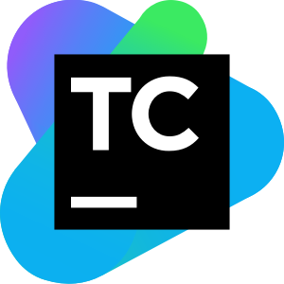


Implementation Of CI/CD
Here is a list of the popular tools available for building CI/CD pipelines:
Notes:
Trainer Notes: List the tools

Slide 32
CI/CD Tool Selection

Slide 33
CI/CD Tool Selection
Here are the list of parameters you should consider when selecting a CI/CD tool:
Usability
Integrations and software support
Container support
Library of reusable code
Hosting options
CI/CD Prerequisites
Notes:
Trainer Notes: Explain the params
Hosting options: Cloud-based tools hosted on the provider’s side require minimal configurations and can be adjusted on demand, whereas self-hosted solutions depend on your DevOps team for deployment and maintenance. While on-premises services benefit building process flexibility, hosted solutions spare the setup hardships offering greater scalability.
Integrations and software support: A CI tool must be flexible enough to support various types of build tools like Make, Shell Scripts, Ant, Maven, Gradle, and version control software like Subversion, Perforce, Git, etc.
Usability: A well-designed interface can save your time at the onboarding stage.
Container support: Having a deployment plugin or configuration for container orchestration tools like Kubernetes and Docker makes it easy for a CI tool to connect to the application’s target environment.
Library of reusable code: A solution with a varied public store of assorted plugins and usable build steps is preferable.

Slide 34
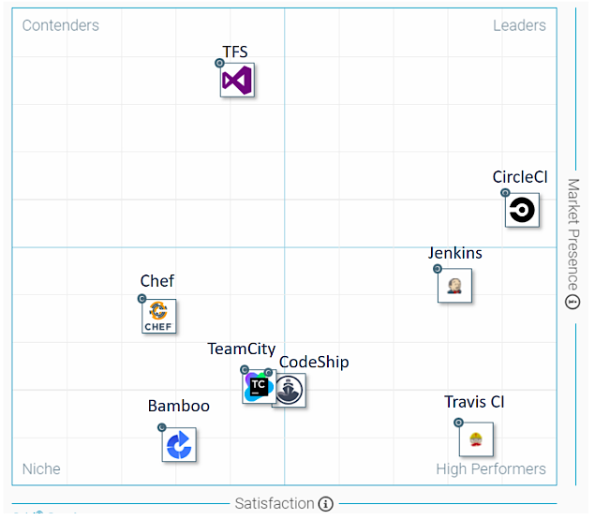
CI/CD Tool Selection
Here is a graph comparing the ratings for various CI/CD tools on StackShare, G2 Crowd, and Slant.co, categorizing them into leader, high-performers, niche, and contenders:
Source: https://www.altexsoft.com/media/2019/02/word-image-55.png
Notes:
Trainer Notes: Compare the tools
G2 Crowd Grid of the mid-market CI tools divided into leaders (CircleCI), high performers (Travis CI and Jenkins), niche (CodeShip, TeamCity, Bamboo, and Chef), and contenders represented by TFS

Slide 35

Introduction to Jenkins
Jenkins is an open-source project written in Java.
It supports Windows, macOS and other Unix-like operating systems.
It’s free, community-supported, and is a popular first-choice tool for Continuous Integration.
Jenkins is primarily deployed on-premises, but it can also run on cloud servers.
Notes:
Trainer Notes: Introduce Jenkins
Its integration with Docker and Kubernetes takes advantage of containers and performs even more frequent releases.

Slide 36
Benefits of Jenkins
Rich plugins library
Limitless integrations
Active community
No expenses required
Distribution of builds and test loads on multiple machines
Notes:
Trainer Notes: Explain the topic
No expenses required.
Jenkins is a free CI tool and is cost effective.
Limitless integrations.
Jenkins can integrate with almost any external program used for developing applications.
Jenkins has a rich library of plugins.
The Jenkins community encourages users to extend the functionality with new features by providing teaching resources.
Active community.
The Jenkins community provides a comprehensive documentation, basic and advanced tutorials, and they also hold an annual conference called the DevOps World | Jenkins World.
Distribution of builds and test loads on multiple machines.
Jenkins uses a Master-Slave architecture, where master is the main server that monitors slaves or remote machines used for distributing software builds and test loads.

Slide 37
Drawbacks of Jenkins
Poor UI
The Jenkins interface seems a bit outdated as it doesn’t follow modern design principles.
2
Manual effort for monitoring
The Jenkins server and its slaves have to be manually monitored to understand interdependencies among the plugins and to upgrade them.
Insufficient Documentation
The documentation sometimes lacks info.
3
1
Notes:
Trainer Notes: Explain the topic
The documentation lacks info on pipelines creation.

Slide 38
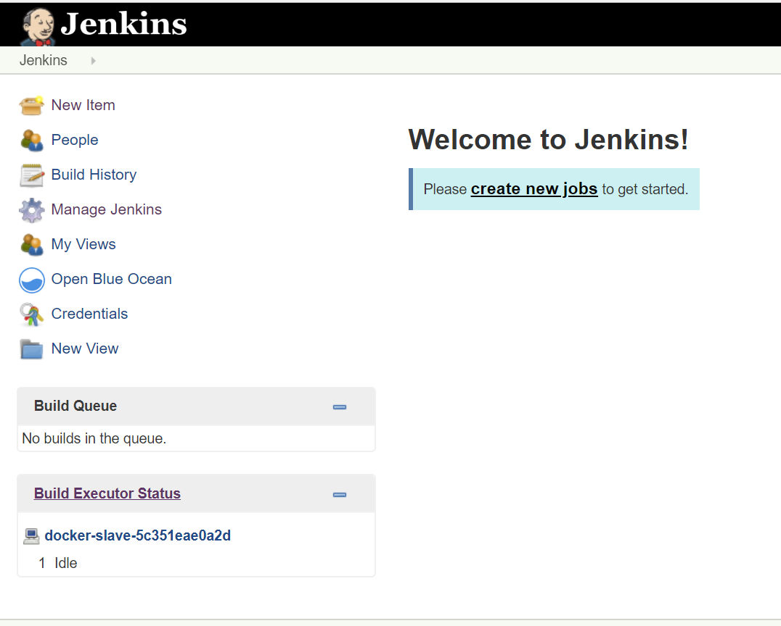
Drawbacks of Jenkins
The picture below shows a screenshot of the Jenkins UI.
Notes:
Trainer Notes: Explain the topic
Poor UI

Slide 39

Introduction to TeamCity
TeamCity by JetBrains is a reliable and high-quality CI server.
It has a good number of authentication, deployment, and testing features, and also supports Docker.
It’s a cross-platform tool and supports all the recent versions of Windows, Linux, and macOS.
It works with Solaris, FreeBSD, IBM z/OS, and HP-UX.
Notes:
Trainer Notes: Explain the topic
It offers unique features like detailed history reports, instant feedback on test failures, and reusable settings.
TeamCity offers a free version with full access to all product features which is limited to 100 build configurations and three build agents.
It also offers a 60-day cloud trial that bypasses on-premises installation.
The price of the enterprise edition varies depending on the number of agents included.
It also gives a 50 percent discount for startups and free licenses for open source projects.

Slide 40
Benefits of TeamCity
Competent docs
Extensive VSC support
Ease of setup
.NET support
Built-in features
Notes:
Trainer Notes: Explain the topic
.NET support
TeamCity integrates with .NET tooling better than any other CI tool and has .NET tools, such as code coverage analysis, several .NET testing frameworks, and static code analysis included.
Extensive VSC support
TeamCity allows for creating projects from just a VCS repository URL and supports all of the popular VCS: AccuRev, ClearCase, CVS, Git, Gnu bazaar, Mercurial, Perforce, Borland StarTeam, Subversion, Team Foundation Server, SourceGear Vault, Visual SourceSafe, and IBM Rational ClearCase.
Competent docs
The documentation is thorough, extensive and explains the overall functionality in detail.
Ease of setup
TeamCity is easy to set up and ready to work right after installation.
Built-in features
TeamCity provides a good set of out-of-the-box functions for building a project.

Slide 41
Drawbacks of TeamCity
Steep learning curve
TeamCity is bit complex and overwhelming for newcomer and may take developers some serious study before they are ready to use the tool in production.
Manual upgrading process
Moving from one major version to another is a long process that has to be done manually on your server.
Notes:
Trainer Notes: Explain the topic

Slide 42

Introduction to Bamboo
Bamboo is a CI/CD tool from Atlassian.
It runs on Windows, Linux, Solaris, and macOS.
Bamboo has features for deployment and release management.
It provides out-of-the-box integration with Atlassian products and integrates natively with other Atlassian products like Bitbucket, Jira, and Confluence.
Notes:
Trainer Notes: Explain the topic
Bamboo is free to try for 30 days.
After the free-trial, the user tier options include unlimited local agents and 10 jobs, and scale up to 1000 remote agents with the price ranging from $10 to $126,500 accordingly.
All Atlassian software is free for any open source project that meets their defined criteria.

Slide 43
Benefits of Bamboo
Multiple notification methods
Bamboo Wallboard shows build results on a dedicated monitor and sends build results to your inbox or your Dev chat room via HipChat or Google Talk.
Rich and simple integration
Bamboo supports most major technology stacks, such as CodeDeploy, Ducker, Maven, Git, SVN, Mercurial, Ant, AWS, Amazon S3 Buckets.
Bitbucket Pipelines
Bitbucket Pipelines which are a Git repository management solution from Atlassian can be fully integrated with Bamboo.
Documentation and support
Bamboo documentation is rich and detailed and Atlassian provides skilled support.
Notes:
Trainer Notes: Explain the topic

Slide 44
Drawbacks of Bamboo
Poor plugin support
In contrast to Jenkins and TeamCity, Bamboo doesn’t support many plugins.
There are only 208 apps currently listed on the Atlassian repository.
Complicated first work experience
Some users complain that the setup process of the first deploy task is complex. It takes time to understand all the different options and how to use them.
Notes:
Trainer Notes: Explain the topic

Slide 45

Introduction to Travis CI
Travis CI is a mature CI solution with simple GitHub integration.It is one of the oldest CI solutions and has won the trust of many users.
Travis CI can perform tests on Linux and macOS, but is not recommended for multi-OS testing.
It has a large, helpful community that welcomes new users and provides a great number of tutorials.
Travis eliminates the need for a dedicated server, as it is hosted in the cloud.
It also offers an on-premises product for companies that want to keep using the same features of the CI tools topped with on-site security needs.
Notes:
Trainer Notes: Explain the topic
The first 100 builds with Travis CI are free.
There are four pricing plans for hobby projects ($69 per month), and for small, growing, and larger teams (from $129 to 489$ per month).
They differ in the number of concurrent jobs that can be run.

Slide 46
Benefits of Travis CI
Good UI
The user interface is very responsive. Most users say that it’s convenient for monitoring builds.
Direct connectivity with GitHub
Travis CI works seamlessly with popular version control systems like GitHub.
Easy setup and configuration
Travis CI requires no installation.
You can begin testing by simply signing up and adding a project.
Backup of the recent build
Whenever you run a new build, Travis CI clones your GitHub repository into a new virtual environment, providing you a backup.
Notes:
Trainer Notes: Explain the topic

Slide 47
Drawbacks of Travis CI
No CD
Travis CI doesn’t allow for continuous delivery.
GitHub-only hosting
Travis only offers support for GitHub-hosted projects.
The teams that use GitLab or any other alternative are forced to rely on another CI tool.
Notes:
Trainer Notes: Explain the topic

Slide 48
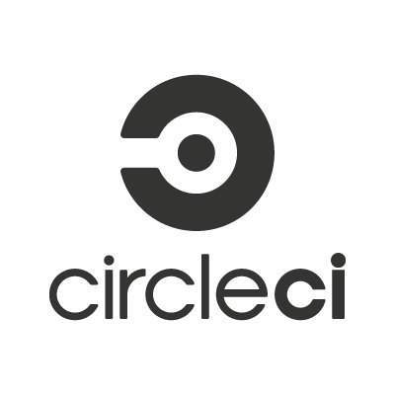
Introduction to CircleCI
CircleCI is a flexible CI tool that offers up to 16x parallelization.
CircleCI is a cloud-based system but also offers an on-prem solution with security and configuration for running the tool in your private cloud or data center.
It notifies users providing only relevant information via email, HipChat, Campfire, and other channels.
CircleCI provides easy setup and maintenance and a free 2-week macOS trial that allows you to build on both Linux and macOS.
Notes:
Trainer Notes: Explain the topic
The free Linux package includes one container. Further configurations require a paid plan.
CircleCI also provides personal usage-based price plan.

Slide 49
Benefits of CircleCI
Test Support
High-quality customer support
Caching of requirements installation and third-party dependencies
Simple UI
No need for manual debugging
Notes:
Trainer Notes: Explain the topic
Simple UI
CircleCI is known for its user-friendly interface for managing builds or jobs.
Its single-page web app is clean and easy to understand.
High-quality customer support
They respond to requests within 12 hours.
Test Support
CircleCI runs all types of software tests including web, mobile, and container environments.
Caching of requirements installation and third-party dependencies
Instead of installing the environments, CircleCI can take data from multiple projects using the granular check-out-key options.
No need for manual debugging
CircleCI has debugging feature Debug via SSH.

Slide 50
Drawbacks of CircleCI
CircleCI changes environment without warning, which may be an issue.
Excessive automation
It is not possible to cache Docker images using a private server.
No caching of Docker images
No testing in Windows OS
CircleCI doesn’t yet allow for building and testing in a Windows environment.
Notes:
Trainer Notes: Explain the topic

Slide 52
What is Continuous Integration?
1
Continuous Integration is a development practice where multiple developers are coding the same functionality.
Continuous Integration is a development practice where you make the changes directly on the production server.
Continuous Integration is a development practice of integrating code into a shared repository.
Continuous Integration is a development practice where you do all the development on the master branch.

Slide 53
What is Continuous Integration?
1
Continuous Integration is a development practice where multiple developers are coding the same functionality.
Continuous Integration is a development practice where you make the changes directly on the production server.
Continuous Integration is a development practice of integrating code into a shared repository.
Continuous Integration is a development practice where you do all the development on the master branch.
C
Continuous Integration is a development practice of integrating code into a shared repository.

Slide 54
Continuous Delivery and Continuous Deployment are synonyms and refer to the same concept. Is the statement true or false?
2
True
False

Slide 55
Continuous Delivery and Continuous Deployment are synonyms and refer to the same concept. Is the statement true or false?
2
True
False
B
There is a subtle difference between Continuous Delivery and Continuous Deployment. The code is automatically deployed to production in Continuous Deployment, whereas deployment is manual in Continuous Delivery.

Slide 56
Which of the following tools does not support CI/CD?
3
Circle CI
Jenkins
TeamCity
Travis CI

Slide 57
Which of the following tools does not support CI/CD?
3
Circle CI
Jenkins
TeamCity
Travis CI
D
Travis CI only supports Continuous Integration and not Continuous Delivery.

Slide 58
Continuous Integration is a development practice of integrating code into a shared repository.
The practice of automatically deploying every successful build directly into production is known as Continuous Deployment.
A CI/CD pipeline is essentially a runnable specification of the steps that need to be performed in order to deliver a new version of a software product.
Popular CI/CD tools include Jenkins, TeamCity, Travis CI, Bamboo, and CircleCI.

